Slide 1
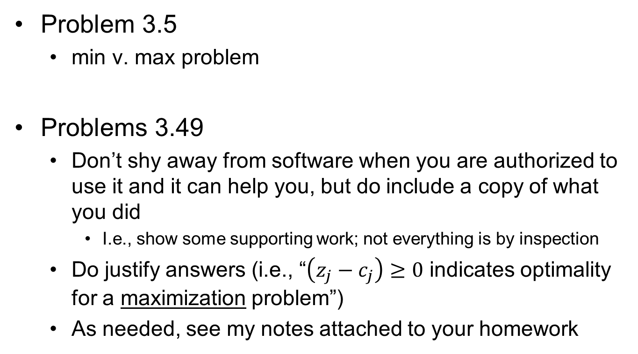
Homework #6 Feedback
Problem 3.5
min v. max problem
Problems 3.49
Don’t shy away from software when you are authorized to use it and it can help you, but do include a copy of what you did
I.e., show some supporting work; not everything is by inspection
Do justify answers (i.e., “$\left(z_{j}−c_{j}\right)≥0$ indicates optimality for a maximization problem”)
As needed, see my notes attached to your homework

Slide 2
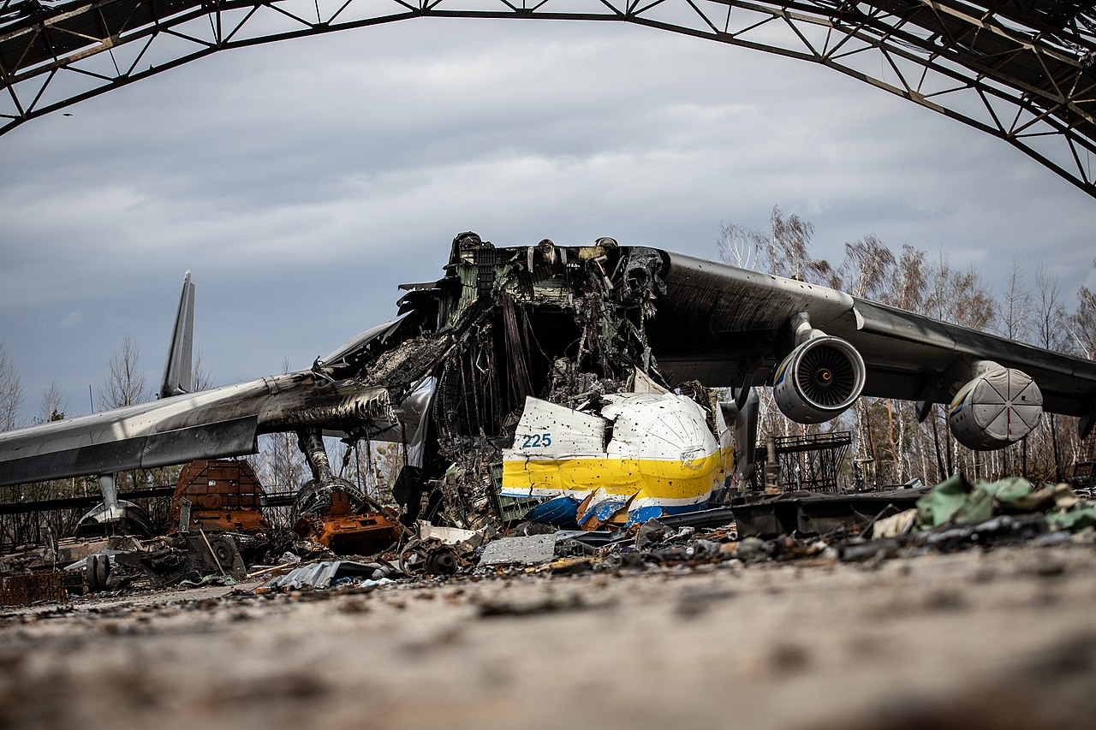
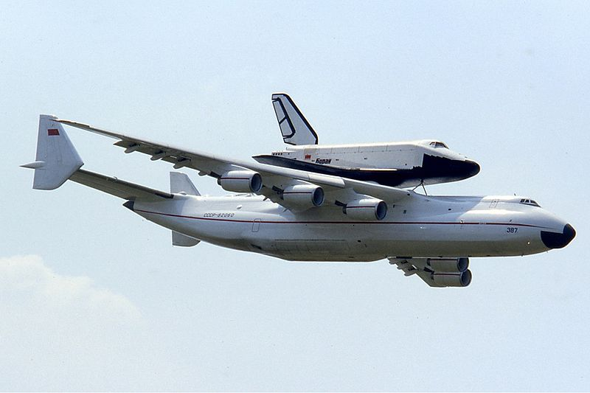
What is it are they?

Slide 3

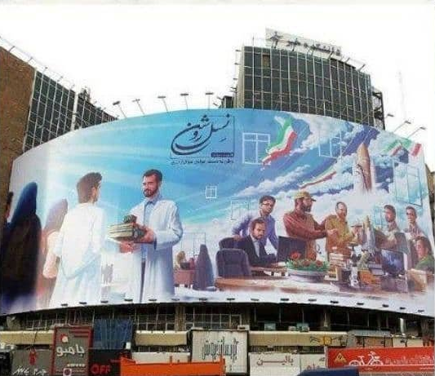
How about this?
Valiasr square
(Tehran)

Slide 4
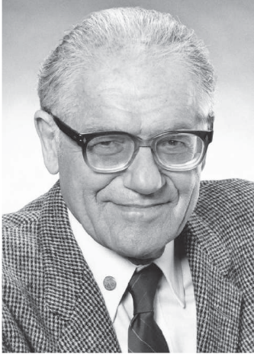
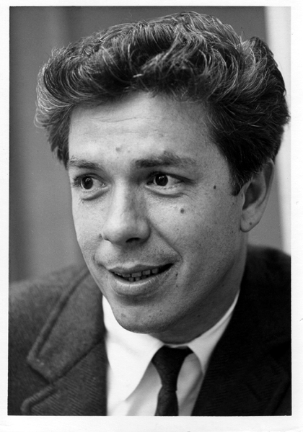
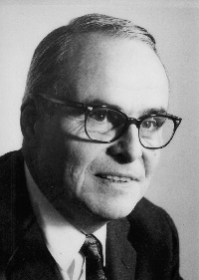
OPER 610 Lesson 09 General Optimality (KKT) Conditions
1917 –1997
1925 – 2014
1905 –1995
Dr Brian J. Lunday
Office: Rm 201E, Bldg 641

Slide 5
Karush’s Thesis
What part of the article interested you the most?

Slide 6
Why KKT Optimality Conditions?
To enable the direct solution of a math program as a system of equations and inequalities, subject to certain conditions
To identify when a solution is optimal or near-optimal

Slide 7
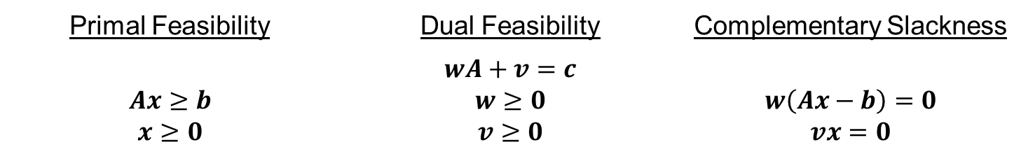

KKT Conditions (Inequality Constrained LPs)
Develop the KKT Conditions to solve an inequality-constrained LP.
$$\begin{matrix}min & cx & \left(associated multipliers\right) \\ s.t. & Ax≥b & \left[w\right] \\ & x≥0 & \left[v\right]\end{matrix}$$
Primal Feasibility | Dual Feasibility | Complementary Slackness
$$Ax≥b$$ $$x≥0$$ | $$wA+v=c$$ $$w≥0$$ $$v≥0$$ | $$w\left(Ax−b\right)=0$$ $$vx=0$$

Slide 8
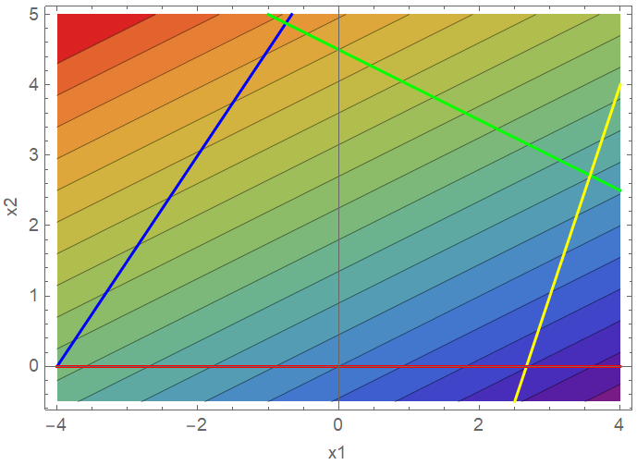
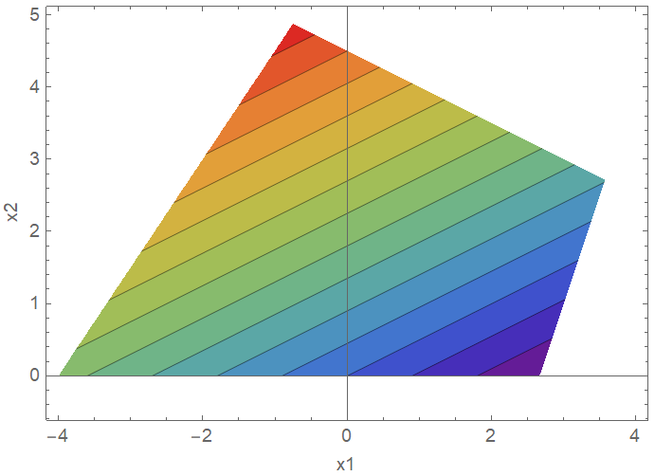

KKT Conditions (Ineq.) (1 of 6)
Develop the KKT Conditions to solve the following LP.
$$\begin{matrix}min & −2x_{1}+4x_{2} \\ s.t. & 3x_{1}−2x_{2}≥−12 \\ & −1x_{1}−2x_{2}≥−9 \\ & −3x_{1}+1x_{2}≥−8 \\ & x_{2}≥0\end{matrix}$$

Slide 9
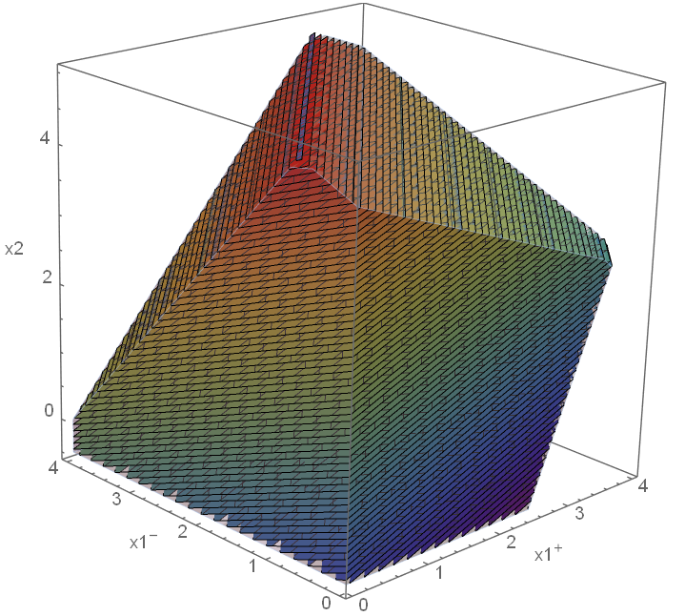
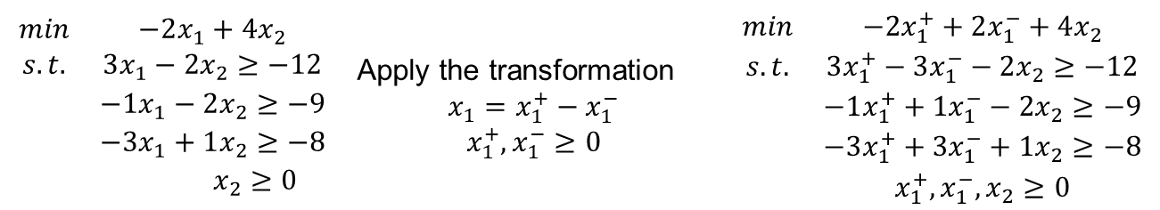
KKT Conditions (Ineq.) (2 of 6)
First, put it in canonical form. (This instance has an unrestricted DV.)
$$\begin{matrix}min & −2x_{1}+4x_{2} \\ s.t. & 3x_{1}−2x_{2}≥−12 \\ & −1x_{1}−2x_{2}≥−9 \\ & −3x_{1}+1x_{2}≥−8 \\ & x_{2}≥0\end{matrix}$$ | Apply the transformation $$x_{1}=x_{1}^{+}−x_{1}^{−}$$ $$x_{1}^{+},x_{1}^{−}≥0$$ | $$\begin{matrix}min & −2x_{1}^{+}+2x_{1}^{−}+4x_{2} \\ s.t. & 3x_{1}^{+}−3x_{1}^{−}−2x_{2}≥−12 \\ & −1x_{1}^{+}+1x_{1}^{−}−2x_{2}≥−9 \\ & −3x_{1}^{+}+3x_{1}^{−}+1x_{2}≥−8 \\ & x_{1}^{+},x_{1}^{−},x_{2}≥0\end{matrix}$$
Figure extends infinitely in the direction $d^{t}=\left[\begin{matrix}1 & 1 & 0\end{matrix}\right]$

Slide 10
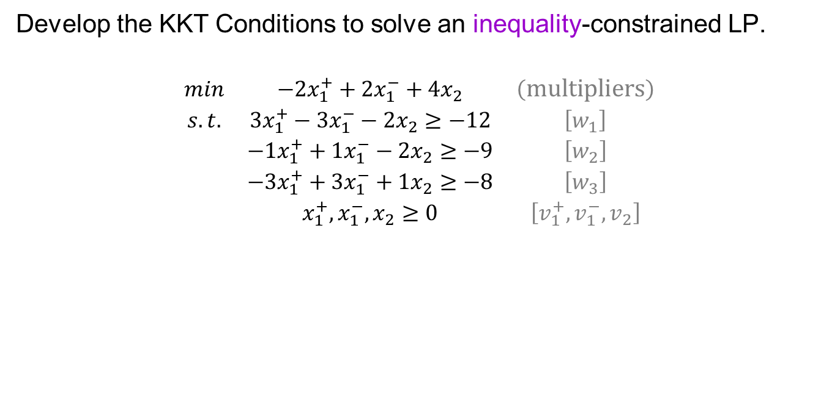
KKT Conditions (Ineq.) (3 of 6)
Develop the KKT Conditions to solve an inequality-constrained LP.
$$\begin{matrix}min & −2x_{1}^{+}+2x_{1}^{−}+4x_{2} & \left(multipliers\right) \\ s.t. & 3x_{1}^{+}−3x_{1}^{−}−2x_{2}≥−12 & \left[w_{1}\right] \\ & −1x_{1}^{+}+1x_{1}^{−}−2x_{2}≥−9 & \left[w_{2}\right] \\ & −3x_{1}^{+}+3x_{1}^{−}+1x_{2}≥−8 & \left[w_{3}\right] \\ & x_{1}^{+},x_{1}^{−},x_{2}≥0 & \left[v_{1}^{+},v_{1}^{−},v_{2}\right]\end{matrix}$$
Primal Feasibility | Dual Feasibility | Complementary Slackness
$$Ax≥b$$ $$x≥0$$ | $$wA+v=c$$ $$w≥0$$ $$v≥0$$ | $$w\left(Ax−b\right)=0$$ $$vx=0$$
The variables $x$ and $v$ are known as a complementary pair of variables.
What vector of variables is the complementary pair to $w$?

Slide 11
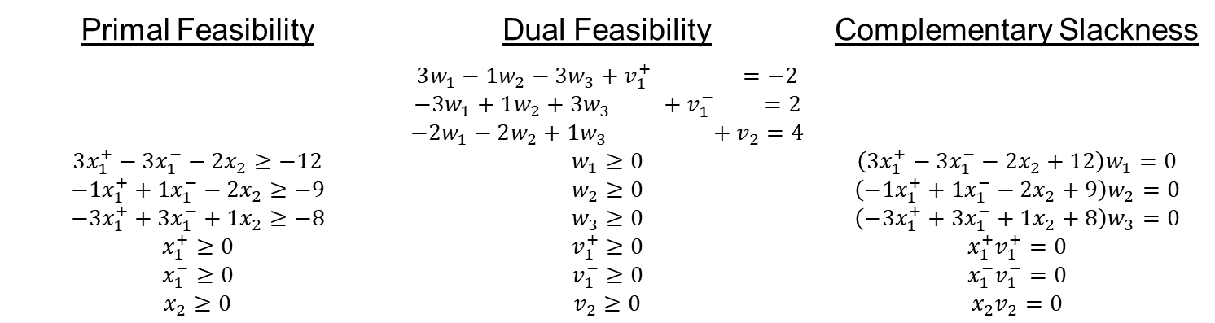

KKT Conditions (Ineq.) (4 of 6)
Develop the KKT Conditions to solve an inequality-constrained LP.
$$\begin{matrix}min & −2x_{1}^{+}+2x_{1}^{−}+4x_{2} & \left(multipliers\right) \\ s.t. & 3x_{1}^{+}−3x_{1}^{−}−2x_{2}≥−12 & \left[w_{1}\right] \\ & −1x_{1}^{+}+1x_{1}^{−}−2x_{2}≥−9 & \left[w_{2}\right] \\ & −3x_{1}^{+}+3x_{1}^{−}+1x_{2}≥−8 & \left[w_{3}\right] \\ & x_{1}^{+},x_{1}^{−},x_{2}≥0 & \left[v_{1}^{+},v_{1}^{−},v_{2} \right]\end{matrix}$$
Primal Feasibility | Dual Feasibility | Complementary Slackness
$$3x_{1}^{+}−3x_{1}^{−}−2x_{2}≥−12$$ $$−1x_{1}^{+}+1x_{1}^{−}−2x_{2}≥−9$$ $$−3x_{1}^{+}+3x_{1}^{−}+1x_{2}≥−8$$ $$x_{1}^{+}≥0$$ $$x_{1}^{−}≥0$$ $$x_{2}≥0$$ | $$3w_{1}−1w_{2}−3w_{3}+v_{1}^{+} =−2$$ $$−3w_{1}+1w_{2}+3w_{3} +v_{1}^{−} =2$$ $$−2w_{1}−2w_{2}+1w_{3} +v_{2}=4$$ $$w_{1}≥0$$ $$w_{2}≥0$$ $$w_{3}≥0$$ $$v_{1}^{+}≥0$$ $$v_{1}^{−}≥0$$ $$v_{2}≥0$$ | $$\left(3x_{1}^{+}−3x_{1}^{−}−2x_{2}+12\right)w_{1}=0$$ $${\left(−1x_{1}^{+}+1x_{1}^{−}−2x_{2}+9\right)w}_{2}=0$$ $$\left(−3x_{1}^{+}+3x_{1}^{−}+1x_{2}+8\right)w_{3}=0$$ $$x_{1}^{+}v_{1}^{+}=0$$ $${x_{1}^{−}v}_{1}^{−}=0$$ $${x_{2}v}_{2}=0$$

Slide 12
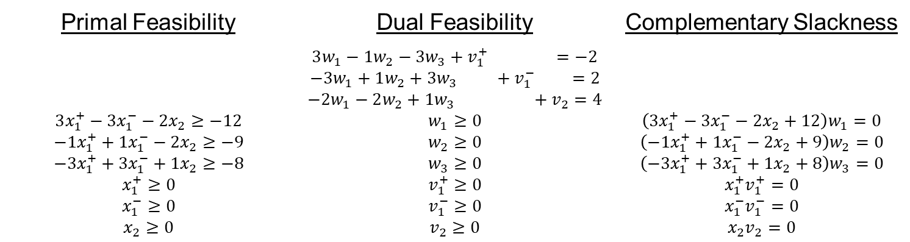
KKT Conditions (Ineq.) (5 of 6)
How do you solve this system of equations and inequalities?
Manually
Condition on the 6 CS conditions
For each of the 2⁶ combinations, attempt to solve the 9 equations & 9 unknowns.
Code an algorithm to solve it
Leverage a computer algebra system (e.g., Mathematica, MATLAB)
Primal Feasibility | Dual Feasibility | Complementary Slackness
$$3x_{1}^{+}−3x_{1}^{−}−2x_{2}≥−12$$ $$−1x_{1}^{+}+1x_{1}^{−}−2x_{2}≥−9$$ $$−3x_{1}^{+}+3x_{1}^{−}+1x_{2}≥−8$$ $$x_{1}^{+}≥0$$ $$x_{1}^{−}≥0$$ $$x_{2}≥0$$ | $$3w_{1}−1w_{2}−3w_{3}+v_{1}^{+} =−2$$ $$−3w_{1}+1w_{2}+3w_{3} +v_{1}^{−} =2$$ $$−2w_{1}−2w_{2}+1w_{3} +v_{2}=4$$ $$w_{1}≥0$$ $$w_{2}≥0$$ $$w_{3}≥0$$ $$v_{1}^{+}≥0$$ $$v_{1}^{−}≥0$$ $$v_{2}≥0$$ | $$\left(3x_{1}^{+}−3x_{1}^{−}−2x_{2}+12\right)w_{1}=0$$ $${\left(−1x_{1}^{+}+1x_{1}^{−}−2x_{2}+9\right)w}_{2}=0$$ $$\left(−3x_{1}^{+}+3x_{1}^{−}+1x_{2}+8\right)w_{3}=0$$ $$x_{1}^{+}v_{1}^{+}=0$$ $${x_{1}^{−}v}_{1}^{−}=0$$ $${x_{2}v}_{2}=0$$

Slide 13
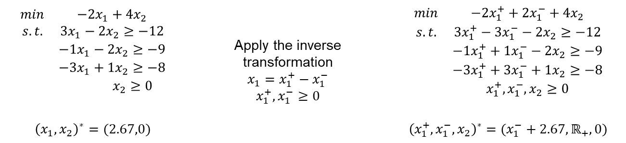
KKT Conditions (Ineq.) (6 of 6)
Identify the optimal solution to the original formulation.
$$\begin{matrix}min & −2x_{1}+4x_{2} \\ s.t. & 3x_{1}−2x_{2}≥−12 \\ & −1x_{1}−2x_{2}≥−9 \\ & −3x_{1}+1x_{2}≥−8 \\ & x_{2}≥0\end{matrix}$$ | Apply the inverse transformation $$x_{1}=x_{1}^{+}−x_{1}^{−}$$ $$x_{1}^{+},x_{1}^{−}≥0$$ | $$\begin{matrix}min & −2x_{1}^{+}+2x_{1}^{−}+4x_{2} \\ s.t. & 3x_{1}^{+}−3x_{1}^{−}−2x_{2}≥−12 \\ & −1x_{1}^{+}+1x_{1}^{−}−2x_{2}≥−9 \\ & −3x_{1}^{+}+3x_{1}^{−}+1x_{2}≥−8 \\ & x_{1}^{+},x_{1}^{−},x_{2}≥0\end{matrix}$$
$${\left(x_{1},x_{2}\right)}^{∗}=(2.67,0)$$ |  | $${\left(x_{1}^{+},x_{1}^{−},x_{2}\right)}^{∗}=(x_{1}^{−}+2.67,ℝ_{+},0)$$

Slide 14
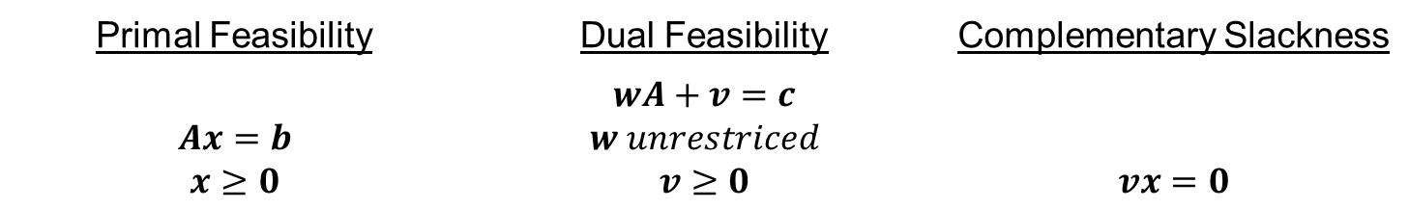

KKT Conditions (Equality Constrained LPs)
Develop the KKT Conditions to solve an equality-constrained LP.
$$\begin{matrix}min & cx & \left(associated multipliers\right) \\ s.t. & Ax=b & \left[w\right] \\ & x≥0 & \left[v\right]\end{matrix}$$
Primal Feasibility | Dual Feasibility | Complementary Slackness
$$Ax=b$$ $$x≥0$$ | $$wA+v=c$$ $$w unrestriced$$ $$v≥0$$ | $$vx=0$$
Note the “reduction” in the number of complementary slackness constraints.

Slide 15
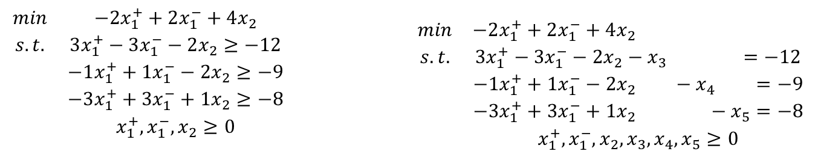
KKT Conditions (Eq.) (1 of 4)
First, put it in standard form.
$$\begin{matrix}min & −2x_{1}^{+}+2x_{1}^{−}+4x_{2} \\ s.t. & 3x_{1}^{+}−3x_{1}^{−}−2x_{2}≥−12 \\ & −1x_{1}^{+}+1x_{1}^{−}−2x_{2}≥−9 \\ & −3x_{1}^{+}+3x_{1}^{−}+1x_{2}≥−8 \\ & x_{1}^{+},x_{1}^{−},x_{2}≥0\end{matrix}$$ |  | $$\begin{matrix}min & −2x_{1}^{+}+2x_{1}^{−}+4x_{2} \\ s.t. & 3x_{1}^{+}−3x_{1}^{−}−2x_{2}−x_{3} =−12 \\ & −1x_{1}^{+}+1x_{1}^{−}−2x_{2} −x_{4} =−9 \\ & −3x_{1}^{+}+3x_{1}^{−}+1x_{2} −x_{5}=−8 \\ & x_{1}^{+},x_{1}^{−},x_{2},x_{3},x_{4},x_{5}≥0\end{matrix}$$

Slide 16
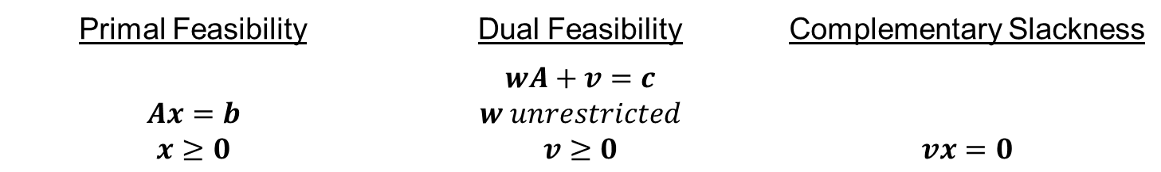
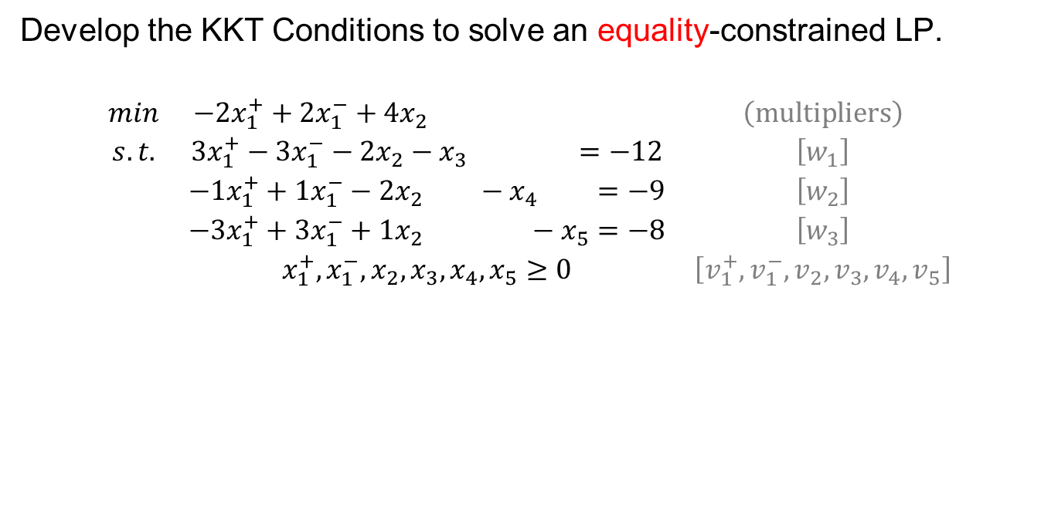
KKT Conditions (Eq.) (2 of 4)
Develop the KKT Conditions to solve an equality-constrained LP.
$$\begin{matrix}min & −2x_{1}^{+}+2x_{1}^{−}+4x_{2} & \left(multipliers\right) \\ s.t. & 3x_{1}^{+}−3x_{1}^{−}−2x_{2}−x_{3} =−12 & \left[w_{1}\right] \\ & −1x_{1}^{+}+1x_{1}^{−}−2x_{2} −x_{4} =−9 & \left[w_{2}\right] \\ & −3x_{1}^{+}+3x_{1}^{−}+1x_{2} −x_{5}=−8 & \left[w_{3}\right] \\ & x_{1}^{+},x_{1}^{−},x_{2},x_{3},x_{4},x_{5}≥0 & \left[v_{1}^{+},v_{1}^{−},v_{2},v_{3},v_{4},v_{5}\right]\end{matrix}$$
Primal Feasibility | Dual Feasibility | Complementary Slackness
$$Ax=b$$ $$x≥0$$ | $$wA+v=c$$ $$w unrestricted$$ $$v≥0$$ | $$vx=0$$

Slide 17
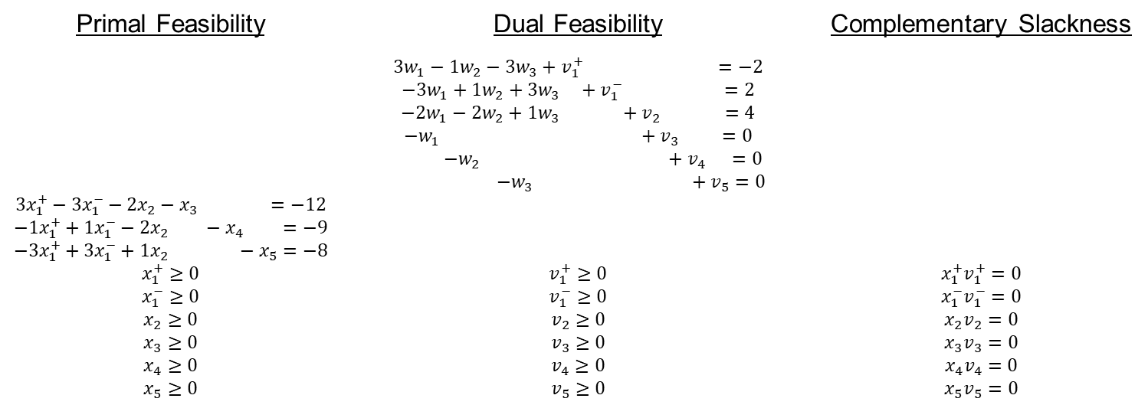

KKT Conditions (Eq.) (3 of 4)
Develop the KKT Conditions to solve an equality-constrained LP.
$$\begin{matrix}min & −2x_{1}^{+}+2x_{1}^{−}+4x_{2} & \left(multipliers\right) \\ s.t. & 3x_{1}^{+}−3x_{1}^{−}−2x_{2}−x_{3} =−12 & \left[w_{1}\right] \\ & −1x_{1}^{+}+1x_{1}^{−}−2x_{2} −x_{4} =−9 & \left[w_{2}\right] \\ & −3x_{1}^{+}+3x_{1}^{−}+1x_{2} −x_{5}=−8 & \left[w_{3}\right] \\ & x_{1}^{+},x_{1}^{−},x_{2},x_{3},x_{4},x_{5}≥0 & \left[v_{1}^{+},v_{1}^{−},v_{2},v_{3},v_{4},v_{5}\right]\end{matrix}$$
Primal Feasibility | Dual Feasibility | Complementary Slackness
$$3x_{1}^{+}−3x_{1}^{−}−2x_{2}−x_{3} =−12$$ $$−1x_{1}^{+}+1x_{1}^{−}−2x_{2} −x_{4} =−9$$ $$−3x_{1}^{+}+3x_{1}^{−}+1x_{2} −x_{5}=−8$$ $$x_{1}^{+}≥0$$ $$x_{1}^{−}≥0$$ $$x_{2}≥0$$ $$x_{3}≥0$$ $$x_{4}≥0$$ $$x_{5}≥0$$ | $$3w_{1}−1w_{2}−3w_{3}+v_{1}^{+} =−2$$ $$−3w_{1}+1w_{2}+3w_{3} +v_{1}^{−} =2$$ $$−2w_{1}−2w_{2}+1w_{3} +v_{2} =4$$ $$−w_{1} +v_{3} =0$$ $−w_{2} +v_{4} =0$ $$−w_{3} +v_{5}=0$$ $$v_{1}^{+}≥0$$ $$v_{1}^{−}≥0$$ $$v_{2}≥0$$ $$v_{3}≥0$$ $$v_{4}≥0$$ $$v_{5}≥0$$ | $$x_{1}^{+}v_{1}^{+}=0$$ $${x_{1}^{−}v}_{1}^{−}=0$$ $${x_{2}v}_{2}=0$$ $${x_{3}v}_{3}=0$$ $${x_{4}v}_{4}=0$$ $${x_{5}v}_{5}=0$$

Slide 18
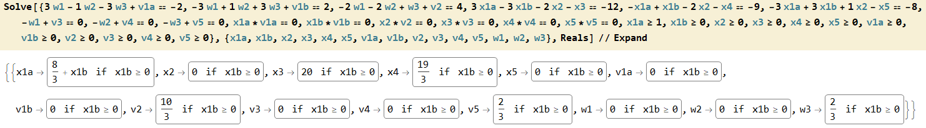
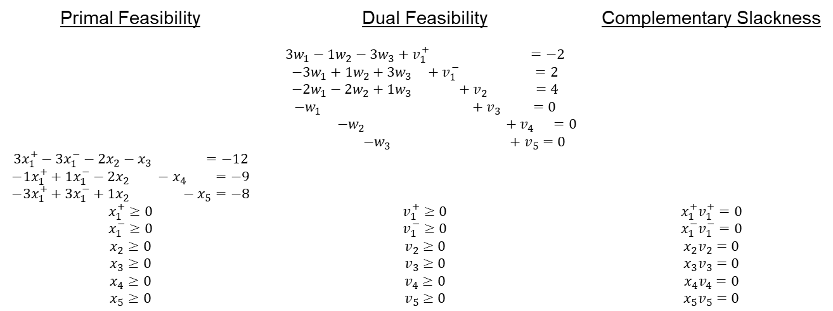
KKT Conditions (Eq.) (4 of 4)
How do you solve this system of equations and inequalities?
It can even make a Computer Algebra System struggle a little bit
Primal Feasibility | Dual Feasibility | Complementary Slackness
$$3x_{1}^{+}−3x_{1}^{−}−2x_{2}−x_{3} =−12$$ $$−1x_{1}^{+}+1x_{1}^{−}−2x_{2} −x_{4} =−9$$ $$−3x_{1}^{+}+3x_{1}^{−}+1x_{2} −x_{5}=−8$$ $$x_{1}^{+}≥0$$ $$x_{1}^{−}≥0$$ $$x_{2}≥0$$ $$x_{3}≥0$$ $$x_{4}≥0$$ $$x_{5}≥0$$ | $$3w_{1}−1w_{2}−3w_{3}+v_{1}^{+} =−2$$ $$−3w_{1}+1w_{2}+3w_{3} +v_{1}^{−} =2$$ $$−2w_{1}−2w_{2}+1w_{3} +v_{2} =4$$ $$−w_{1} +v_{3} =0$$ $−w_{2} +v_{4} =0$ $$−w_{3} +v_{5}=0$$ $$v_{1}^{+}≥0$$ $$v_{1}^{−}≥0$$ $$v_{2}≥0$$ $$v_{3}≥0$$ $$v_{4}≥0$$ $$v_{5}≥0$$ | $$x_{1}^{+}v_{1}^{+}=0$$ $${x_{1}^{−}v}_{1}^{−}=0$$ $${x_{2}v}_{2}=0$$ $${x_{3}v}_{3}=0$$ $${x_{4}v}_{4}=0$$ $${x_{5}v}_{5}=0$$

Slide 19
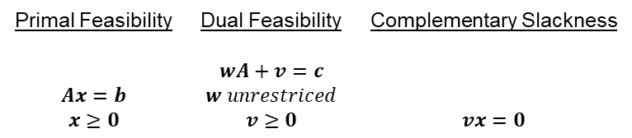
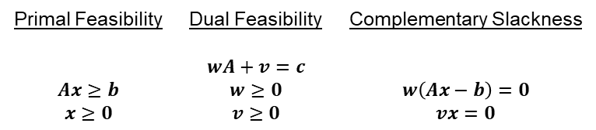
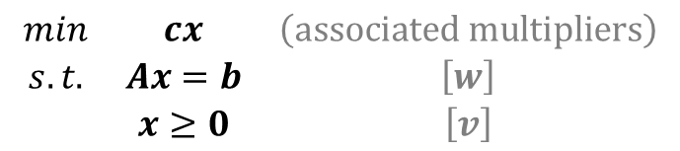

KKT for Canonical or Standard Form LPs
Which system is easier to solve? Why?
Canonical Form
Standard Form
$$\begin{matrix}min & cx & \left(associated multipliers\right) \\ s.t. & Ax≥b & \left[w\right] \\ & x≥0 & \left[v\right]\end{matrix}$$
$$\begin{matrix}min & cx & \left(associated multipliers\right) \\ s.t. & Ax=b & \left[w\right] \\ & x≥0 & \left[v\right]\end{matrix}$$
Primal Feasibility | Dual Feasibility | Complementary Slackness
$$Ax≥b$$ $$x≥0$$ | $$wA+v=c$$ $$w≥0$$ $$v≥0$$ | $$w\left(Ax−b\right)=0$$ $$vx=0$$
Primal Feasibility | Dual Feasibility | Complementary Slackness
$$Ax=b$$ $$x≥0$$ | $$wA+v=c$$ $$w unrestriced$$ $$v≥0$$ | $$vx=0$$

Slide 20
Discussion Questions
What are the advantages to solving LPs directly via the KKT Conditions?
How do the KKT conditions relate to the Simplex Method?

Slide 21
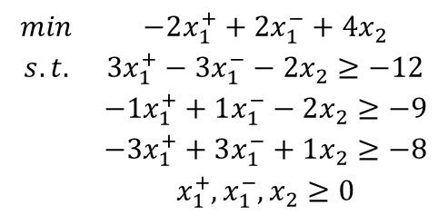
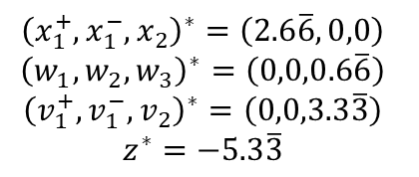
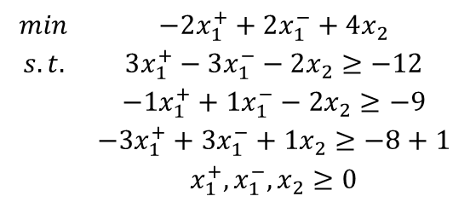


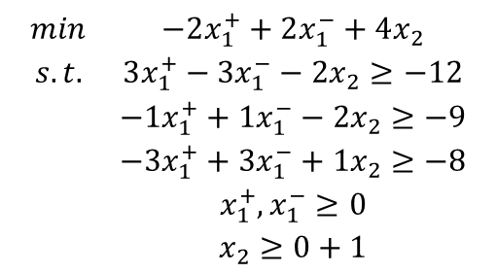
On the Significance of KKT Multipliers at Optimality
$$\begin{matrix}min & −2x_{1}^{+}+2x_{1}^{−}+4x_{2} \\ s.t. & 3x_{1}^{+}−3x_{1}^{−}−2x_{2}≥−12 \\ & −1x_{1}^{+}+1x_{1}^{−}−2x_{2}≥−9 \\ & −3x_{1}^{+}+3x_{1}^{−}+1x_{2}≥−8 \\ & x_{1}^{+},x_{1}^{−},x_{2}≥0\end{matrix}$$
$${\left(x_{1}^{+},x_{1}^{−},x_{2}\right)}^{∗}=\left(2.6\overline{6},0,0\right)$$
$${\left(w_{1},w_{2},w_{3}\right)}^{∗}=\left(0,0,0.6\overline{6}\right)$$
$${\left(v_{1}^{+},v_{1}^{−},v_{2}\right)}^{∗}=\left(0,0,3.3\overline{3}\right)$$
$$z^{∗}=−5.3\overline{3}$$
$$\begin{matrix}min & −2x_{1}^{+}+2x_{1}^{−}+4x_{2} \\ s.t. & 3x_{1}^{+}−3x_{1}^{−}−2x_{2}≥−12 \\ & −1x_{1}^{+}+1x_{1}^{−}−2x_{2}≥−9 \\ & −3x_{1}^{+}+3x_{1}^{−}+1x_{2}≥−8+1 \\ & x_{1}^{+},x_{1}^{−},x_{2}≥0\end{matrix}$$
$$\begin{matrix}min & −2x_{1}^{+}+2x_{1}^{−}+4x_{2} \\ s.t. & 3x_{1}^{+}−3x_{1}^{−}−2x_{2}≥−12 \\ & −1x_{1}^{+}+1x_{1}^{−}−2x_{2}≥−9 \\ & −3x_{1}^{+}+3x_{1}^{−}+1x_{2}≥−8 \\ & x_{1}^{+},x_{1}^{−}≥0 \\ & x_{2}≥0+1\end{matrix}$$
$$z^{∗}=−4.6\overline{6}$$
$$z^{∗}=−2$$

Slide 22
Questions & Discussion

Slide 23
For next class
Sections 6.1-6.3
Homework #8: Problems 5.35 & 5.41(a),(d),(e)
For 5.41, you’ll learn more about optimality conditions (and get more comfortable with duality) if you do not transform every problem into a canonical minimization problem.
You’ll also do a lot less work!
But you can still do that if you really want to…

